Slide 1
Registrars and Security
Greg Rattray
Chief Internet Security Advisor

Slide 2
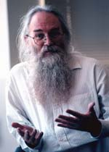
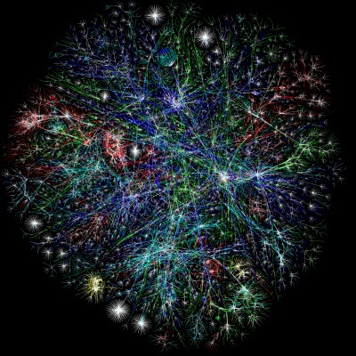
The Internet as an Ecosystem
Built as experiment; now part of everyday life
Assumed benign, cooperative users
Now involves a wide variety of systems,
stakeholders, opportunities & risks
Governments, corporations, civil society, criminals
Malicious actors now use Internet
Growing centers of gravity – economically, socially, militarily
Anonymity & ability to leverage 3rd Parties for Bad Acts
Underground economy is developed
Notes:
Assumed benign, cooperative users -> sounds strange

Slide 3
Bot Nets and Complexity of Attacks
Bot Code
Bot Code
Actors Involved
Code Developers
Botnet Developer (t = X)
Bot Controller (t = Y)
Owners of assets
( C2 and bots)
DNS operators
ISPs
Target (s)
(to include
firewall, IDS, proxies, targeted network asset
Botnet Developer
Attacker
C2
Bot Controller
Multiple purposes;
Possibly no
digital
connection
Bot
Bot
Bot
Routing
DNS resolution
Who’s responsible?
Who should be part of a cooperative mitigation and defense?
Who should be in a investigation/legal enforcement?
Target(s)
Attack the swamps, not the fever
Notes:
Way too busy slide… “Retaliation?” am not sure of the context here.. Retaliation by whom? I think retaliation is wrong word… possibly deterrent?

Slide 4
Exploitation or misuse against domain registration services
Major Hacking Attacks against domain registration accounts around April
DomainZ
5 ccTLD operators
Also victimized:
Coca-Cola
Fanta
F-secure
HSBC
Microsoft
Sony
Xerox

Slide 5
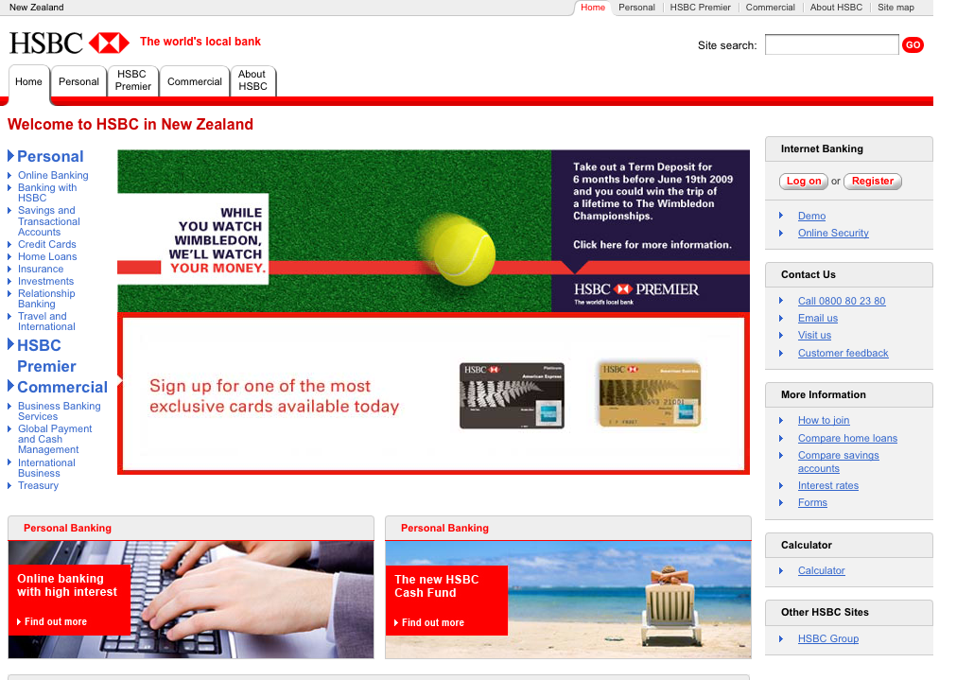
Targeted SQL injection to registration management server
Take-over domain account
Assign new nameservers
Point A record to defacement

Slide 6
What do these incidents reveal? (from SAC040 study)
All an attacker needs to gain control of an entire domain name portfolio is a user account and password
Guess, phish, or socially engineer a single point of contact
Attackers also scan registrar account login portals for web application vulnerabilities
Attacker can change contact and DNS information of ALL domains in the account
Email may be only method registrar employs to notify a registrant of account activity
Attackers know this and block delivery to registrant by altering DNS configuration
Recovery from DNS configuration abuse is slow

Slide 7
Recommendations (from SAC040 study)
Registrars: offer more protection against registration exploitation or misuse
Complement existing measures to protect domain accounts with security measures identified in the SSAC report
Registrars: make information describing measures to protect domain accounts more accessible to customers
Registrars: consider a voluntary, independent security audit as a component of self-imposed security due diligence
ICANN: consider whether a trusted security mark programs would improve registration services security

Slide 8
Avalanche
(Information Source : APWG)

Slide 9
Avalanche the delivery method for the Zeus botnet infector
The pattern seen with Avalanche involves targeting vary registrars/resellers, but also targeting a small number of other providers to test their suitability for future attacks
Fast Flux Domain Hosting
Attacking commercial banking platforms of over 40 financial institutions
Registrars that harden themselves against abuse see sharp reductions in volume

Slide 10
Avalanche Response Successes
InterDomain.es
Dozens of domains daily
Overwhelming complaint calls
Implement unique registration process
New accounts get an SMS verification message
All abuse disappears overnight
Attacks against .UK registrars
Nominet steps in to work with registrars on response
Gets times down to a few hours
.UK temporarily ceases to be hit by Avalanche
(Information Source : APWG)

Slide 11
Situation awareness information sharing
ICANN security team sent out situation awareness bulletins to DNS registration community
Potential attack against ccTLD Registration Systems (Published 13 July 2009)
http://www.icann.org/en/security/sa-2009-0001.htm
High volume criminal phishing attack known as Avalanche the delivery method for the Zeus botnet infector (Published 6 October 2009)
http://www.icann.org/en/security/sa-2009-0002.htm

Slide 12
ERSR Process – gTLD Registries
Security incidents – ongoing issue for registries
Genesis – Conficker
Request process – contractual relief; online form
ICANN response process (see flowchart)
Public comment open thru 16 November
http://www.icann.org/en/public-comment/#ersr

Slide 13
DNS Collaborative Response Process
Events that threaten systemic security, stability and resiliency of the DNS
Events and incidents where the DNS or registration services are exploited and/or misdirected on a large scale attacks where the name service or domain registration service is used to facilitate attacks, or where the DNS infrastructure or registrations services are the targets of malicious activity
Security team contact point – security-ops@icann.org

Slide 14
Registrar Community and DNS Security
Do we need an ERSR for registrars
How can ICANN enhance security posture of registrars?
Info sharing? Best Practices? Training?
Sessions with registrar technical security people?
Do we need a DNS CERT?

